Slide 1
Chapter 13 Correlation

Slide 2
Why Correlation
So far we haven’t looked at the strength or direction of the association between two variables
“Co-relation”:
The relationship between two interval-ratio variables
Correlation:
Describes strength and direction of relationships in a linear fashion

Slide 3
Example: Weight and Height
We know that both are associated because the taller a person is, the more they tend to weigh
Notes:
And this correlation is not PERFECT, because we know that some tall people weigh very little, and some short people weigh a lot.

Slide 4
Example: Education and Income
We know that both are associated because the more educated a person is, the more they tend to make in income
Notes:
And this correlation is not PERFECT, because we know that some tall people weigh very little, and some short people weigh a lot.

Slide 5
Strength of Correlation
Correlations vary in strength
Can visualize using scatterplot
IV on X axis, DV on Y axis
Easier to call one variable X (IV) and the other Y (DV)

Slide 6
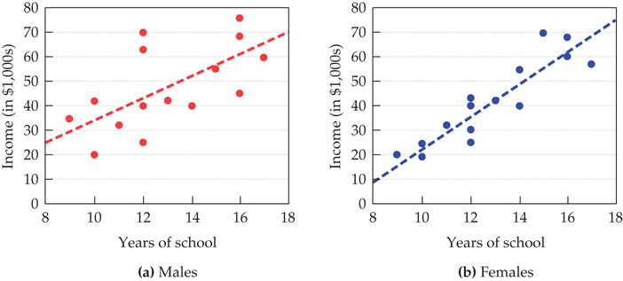
Strength of Correlation
Notes:
One plot for males, one for females
Each point depicts education and income
Correlation stronger when points closely form line
Female correlation between education and income is much stronger since points closer to line
Because this is based on (variation from) the straight line, this is a linear relationship

Slide 7
Strength of Correlation
Perfect correlation means that the every x and y value fall directly on the line (no variation)
Perfect correlation rarely seen in the real world

Slide 8
Direction of Correlation
Positive correlation
Relationships in the SAME direction
As one variable increases, the other variable increases
As one variable decreases, the other variable decreases
Negative correlation
inverse relationship; relationships in the OPPOSITE direction
as the score for one variable increases, the other decreases (vice versa)

Slide 9
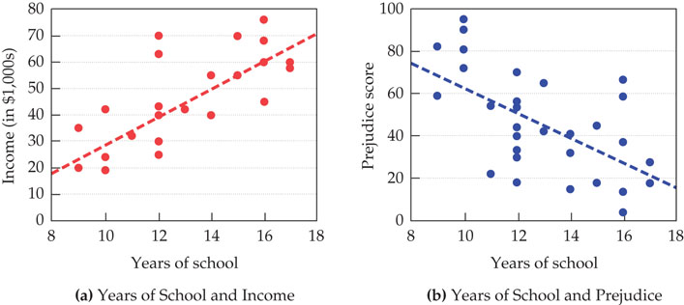
Direction of Correlation
Notes:
Figure (a): relationship between education and income has positive correlation
Figure (b): relationship between education and prejudice has negative correlation
Another linear relationship

Slide 10
Extra: Nonlinear Relationships
Not all relationships between X and Y form a straight line
Curvilinear correlation
one variable increases as the other increases until the relationship reverses itself

Slide 11
Pearson’s Correlation Coefficient (r)
Strength:
The closer to ±1.0, the stronger the relationship
Direction:
Ranges from -1.0 to +1.0
Negative: negative correlation
Positive: positive correlation
-0.7 and +0.7 have the same strength, but different directions

Slide 12
Correlation Strength Cutoffs (Cohen 1988)
Weak/Small Correlation
r less than/equal to .29 (r ≤ .29)
Moderate Correlation
r between .30 and .49 (.30 ≤ r ≤ .49)
Strong Correlation
r greater than/equal to .50 (r ≥ .50)

Slide 13
Pearson’s Correlation Coefficient (r)
Uses the PRODUCT of the X and Y deviations from their means
(X-X)
Example: tells us how much more or less education a person has from the mean education
(Y-Y)
Example: tells us how much more or less income a person makes than the mean income

Slide 14

Pearson’s r

Slide 15

Pearson’s r

Slide 16
Degrees of Freedom
df = N-2

Slide 17
Hypothesis Testing
H₀: No relationship between the variables (in the population)
H₁: There is a relationship between the variables

Slide 18
Hypothesis Testing
The logic is the same as usual, compare our calculated r value to the table r value
If calculated r > table r, reject the null hypothesis
If calculated r < table r, fail to reject the null hypothesis

Slide 19
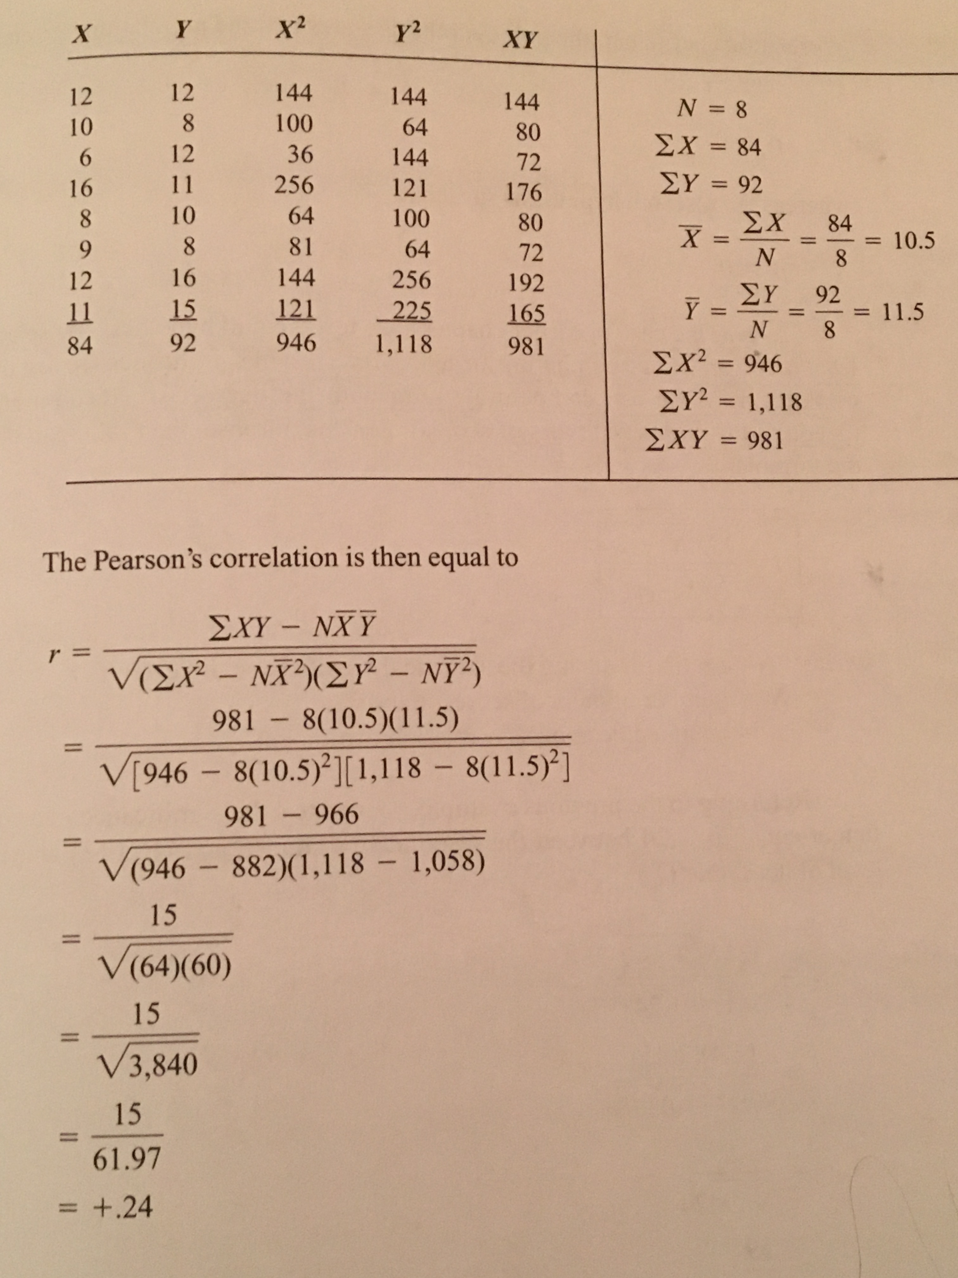
Example: Father’s Education Years (X) and Child’s Education Years (Y)

Slide 20
Example: Father’s Education Years (X) and Child’s Education Years (Y)
Next, we use the following table based on our alpha level (α = .05 or α = .01)
Table will help us determine whether or not our obtained r is significant at either the .05 or .01 level
Begin with the α = .05 table
Select the column associated with our α value and the row associated with our df value, we find the value that intersects both. This is our critical r.
If our obtained r is larger than the critical r, we know our obtained r is significant (at least at the p=.05 level)

Slide 21
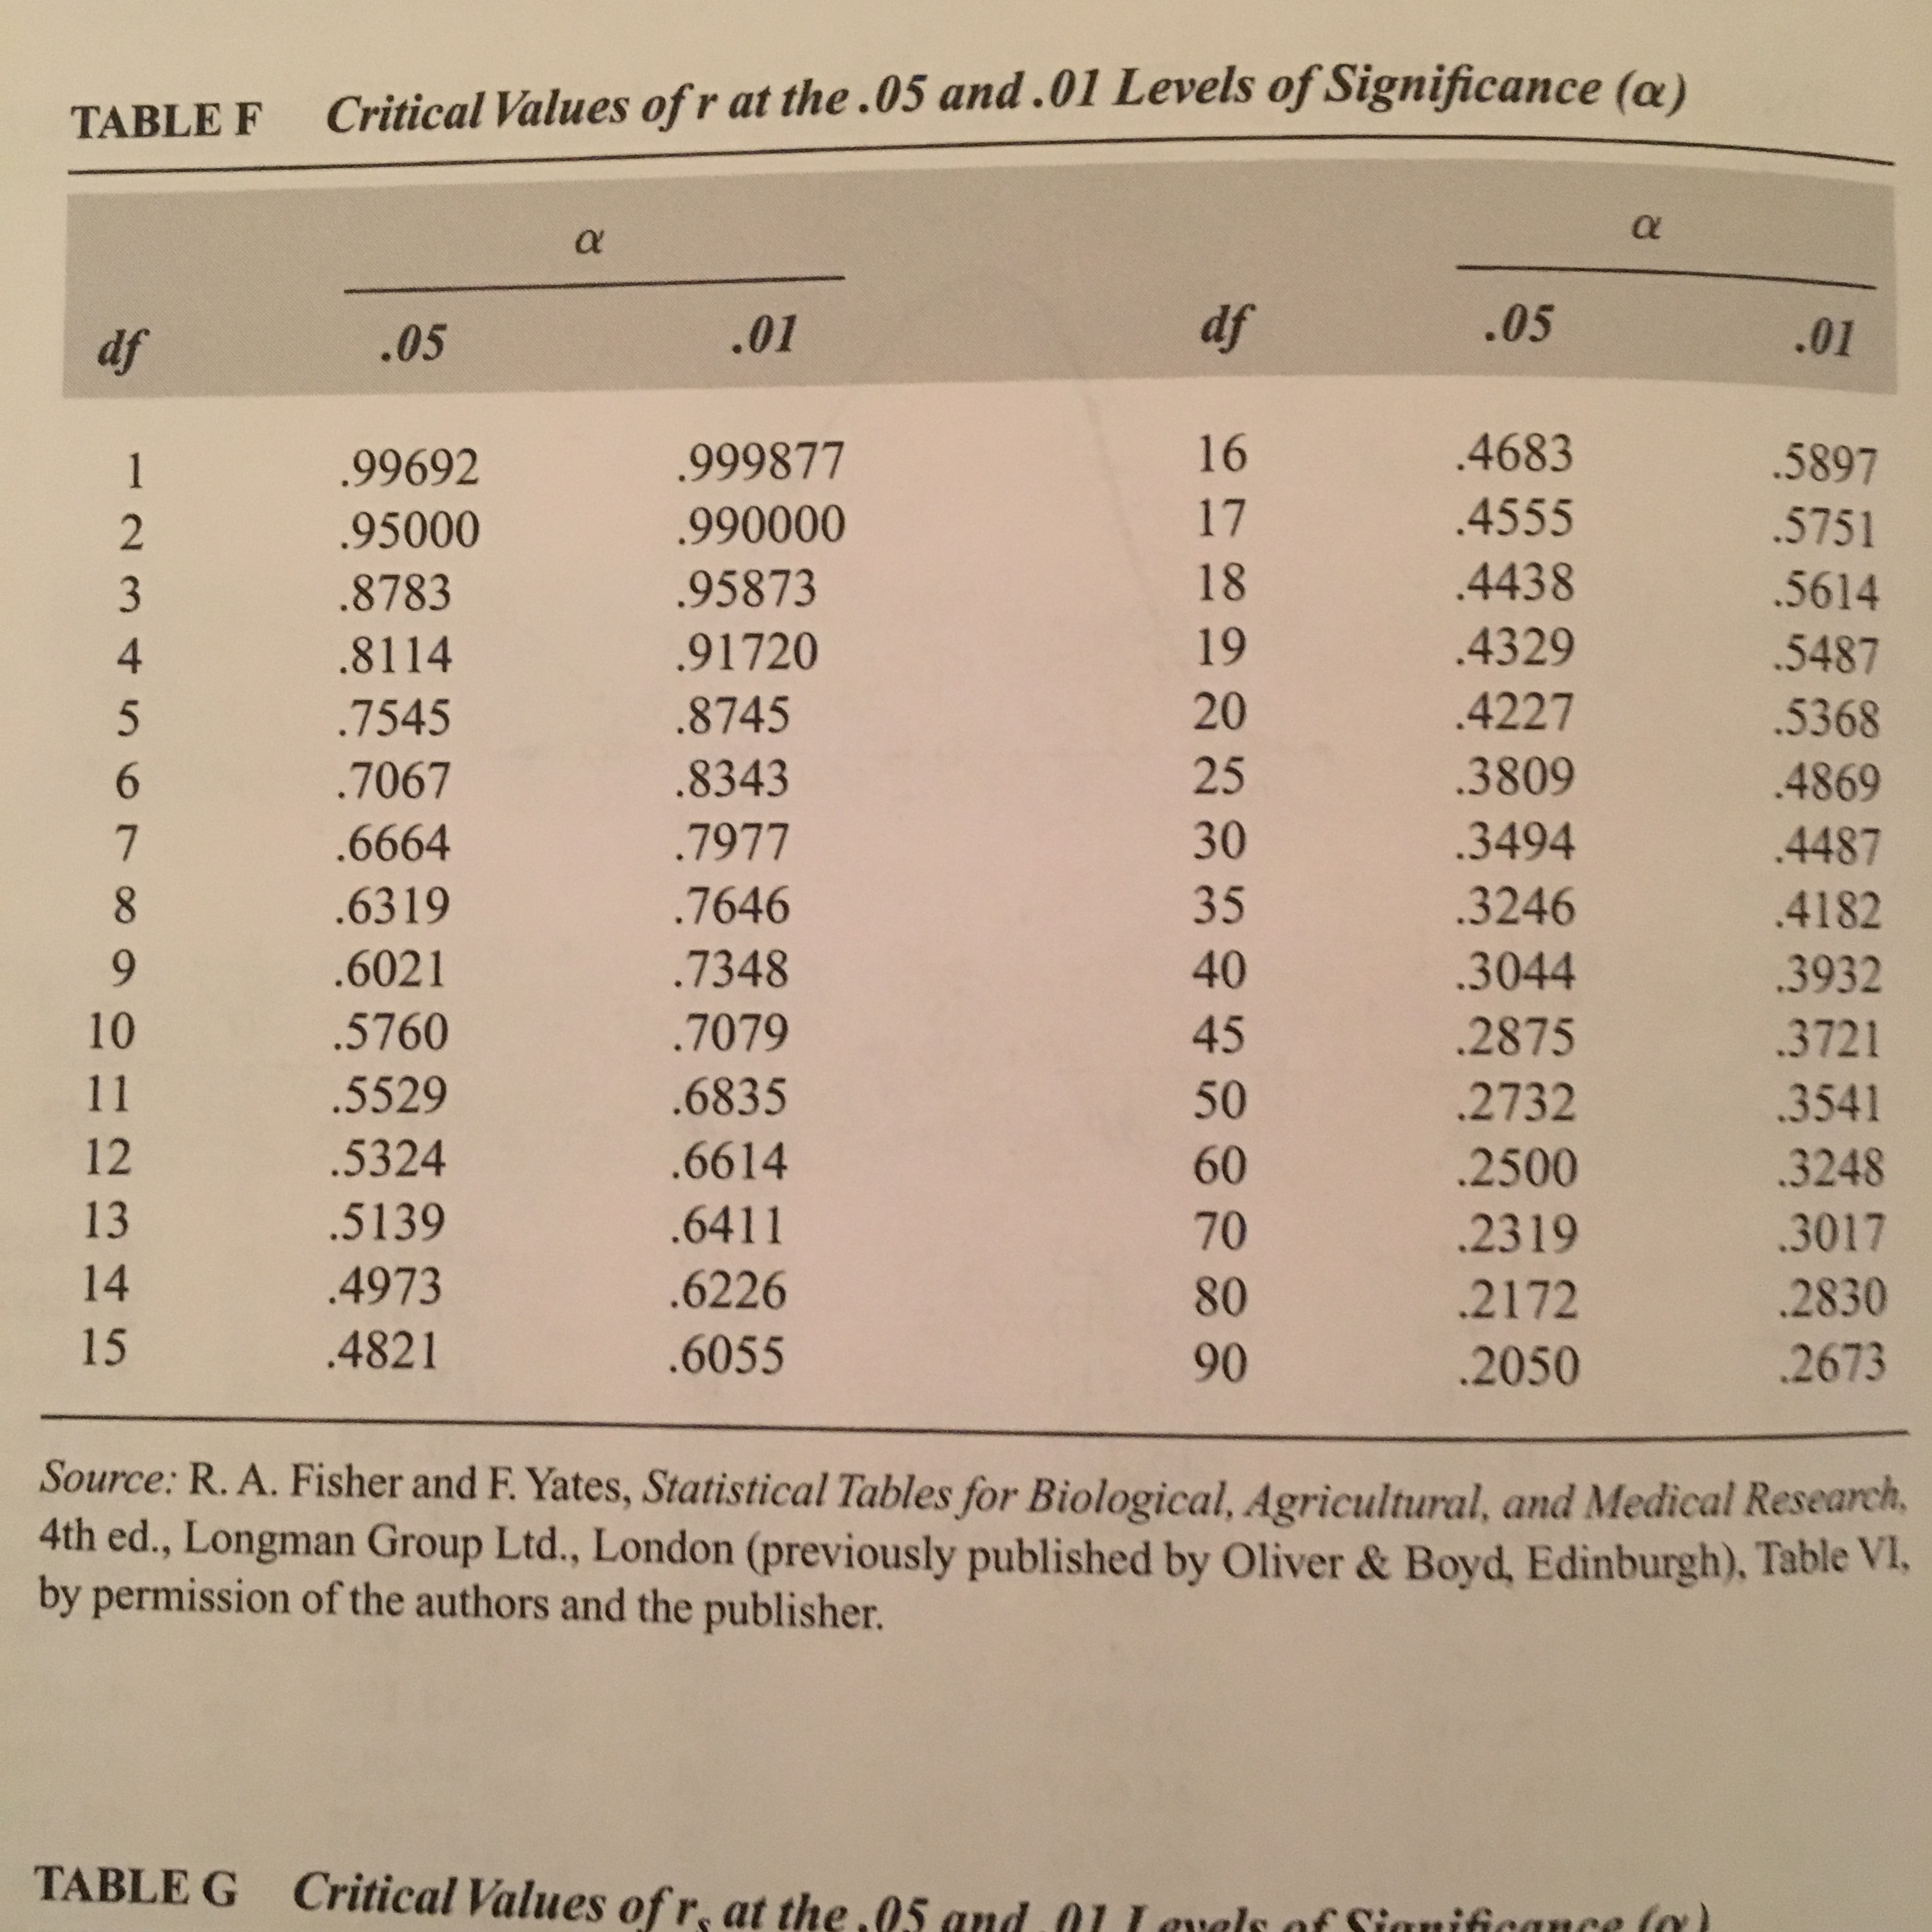
Example: Father’s Education Years (X) and Child’s Education Years (Y)

Slide 22
Example: Father’s Education Years (X) and Child’s Education Years (Y)
In our example, we have the following:
df = 8-2 = 6
r = +.24
In our table (α = .05 ), we follow the df = 6 row and get a critical r = ± .7067
Because our obtained r is smaller than the critical r, we know that our r is not significant, meaning that the relationship (likely) does not exist in the population.
p > .05

Slide 23
Reporting r
Report
The test used
If you reject or fail to reject the null hypothesis
The variables used in the analysis
The degrees of freedom, calculated value of the test, and p-value
r(df) = r value, p-value
“Using the Pearson correlation, I fail to reject the null hypothesis that there is no relationship between father’s education level and child’s education level, r(6) = +.24, p > .05”

Slide 24
Pearson’s Correlation Coefficient (r) Assumptions
Interval variables
Random sampling
Normally distributed characteristics- in small samples especially (N < 30) a skewed distribution will throw off your results

